Slide 1

GBARAN AGC2 EBS Service ID: 65213
Please note: These default picture boxes have a hole cut in them to allow for the ti box to be seen.
To change the picture: Delete the sample picture. Then click the insert picture icon in the middle of the picture box, when the picture appears, use the send to back command.
To crop or adjust the picture: Double click the picture to display the Format ribbon, then click the Crop tool. Then use the white points to crop or positon the picture within the box. Do not use the black crop bars which will change the shape of the picture box. (As shown on slide 12.)
PTME
Miebi Debekeme
PTME Surveillance Engineer

Slide 2
EBS Alert ID: 65213 Event: The ThrustBearing_AxialDisp1 (GBGP GBGR121VE619A/PV.CV) has exceeded the baseline of -306. by more than 1 µm Peak was -255.

Slide 3
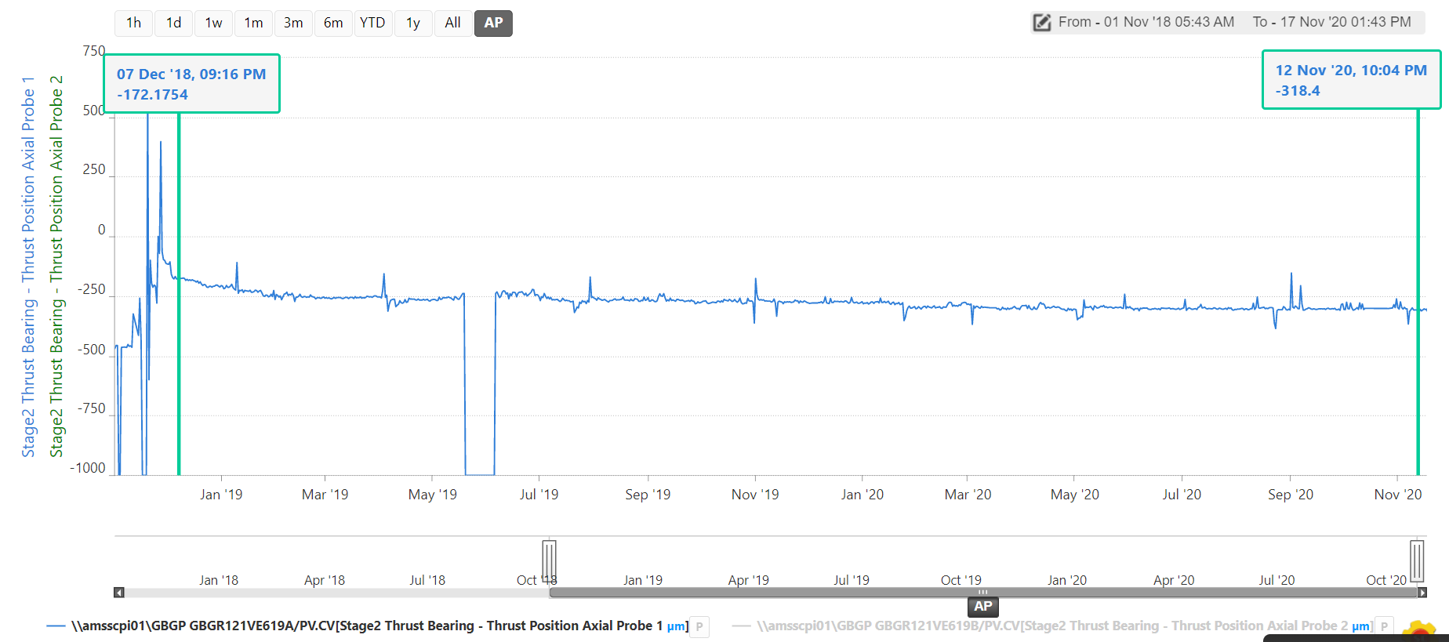
Long term trend (two years) shows a difference of about 146um of probe GBGP GBGR121VE619A
RECOMMENDATION
Check the probe setting (or) Calibration of probe during next opportunity
In case probe readings are actual which indicates rotor is shifting in one direction then rotor recentering needs to be planned.
Check thrust bearing temperature (GBGR121TE620A/B) in DCS

Slide 4
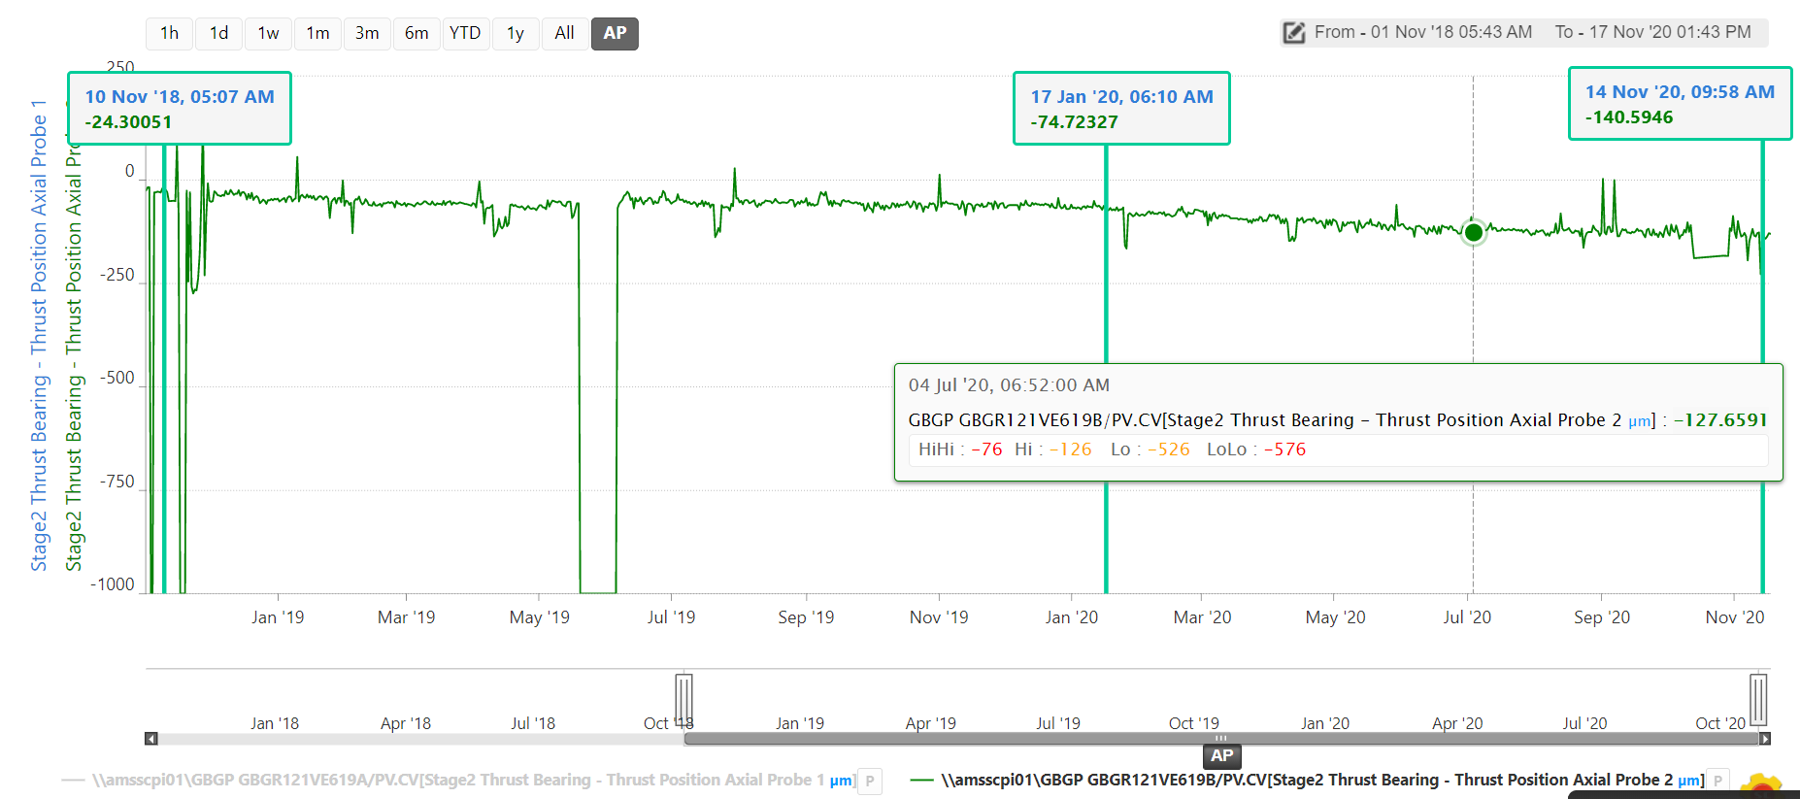
Long term trend (two years) shows a difference of about 120um of probe GBGP GBGR121VE619B
RECOMMENDATION
Same recommendation as in slide 3

